Slide 1
Learning Language
Glenn Davis
Brian Liu
John Reyna
Tamara Prstić
Felis Cum Dentes Adstringit
Notes:
Problem Domain
Within the studio theme of learning, our specific area of focus is language learning

Slide 2

Initial POV
Elise
Notes:
Elise
Uni student China - majoring in English and French
Surprised to find out that she enjoyed everyday interactions in foreign languages the most
Inferred from this viewpoint that it would be game-changing to find ways to facilitate real interactions in a foreign language

Slide 3

More Needfinding
Jeff
From Canada to South Korea
Add picture of your mom here.
Literally.
Notes:
Jeff
Grew up in Canada and took Korean classes at uni for two years
Then moved to South Korea two months ago to work as an English teacher
Locals speak too quickly for him to parse sentences
They use too many words he hasn’t learned
Feels awkward and embarrassed asking the other person to repeat the sentence and confirm the meaning
Text messages easier because can look up words using dictionary and figure out sentence meaning before responding

Slide 4

More Needfinding
John
Native American living in San Francisco
Add picture of your mom here.
Literally.
Notes:
John
Native American in San Francisco
Interview itself did not touch on topics related to language learning, but covered pressing needs related to Native American issues

Slide 5
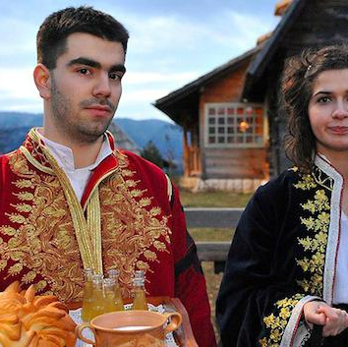
More Needfinding
Branislav
From Serbia to San Francisco
Add picture of your mom here.
Literally.
Notes:
Branislav
Serbian native living in San Francisco and working at Apple
Learned Italian through natural exposure; when he was 9, spent few weeks living with family in Italy who only spoke Italian
Interesting: once learned Tamara spoke Italian, only spoke Italian throughout interview to practice his Italian

Slide 6
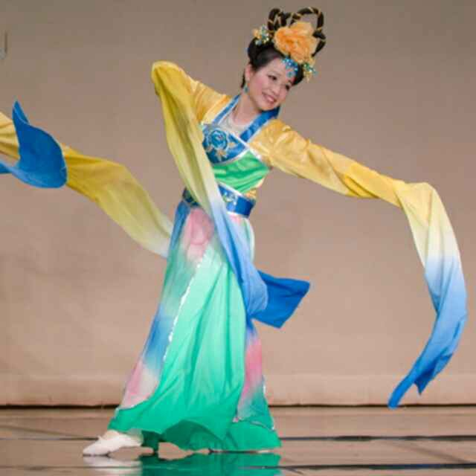
Revised POV #1
We met… Xiuzhi, a foreign medical graduate from China struggling to express herself with English in the United States.
We were amazed to realize… how much she wanted to take the “other person” out of the language learning equation.
It would be game-changing to… eliminate discomfort in communicating with other people or even to eliminate the other party completely.

Slide 7
Revised POV #2
We met… Jeff, a Canadian living in a small town in rural South Korea and working as an English teacher.
We were amazed to realize… that his two years of Korean language classes at a university in Canada did not allow him to communicate effectively in real-life situations.
It would be game-changing to… help him unlock the foundation of Korean that he learned previously and allow him to use it to navigate Korean society.
It would also be game-changing to… bridge the gap between his current level and a self-sustaining level where he could understand daily interactions well enough to be able to learn and improve through communicating with locals.

Slide 8
Revised POV #3
We met… Branislav, a Serbian native living in San Francisco and working at Apple.
We were amazed to realize… that he learned a significant amount of Italian in a couple of weeks living with an Italian family.
It would be game-changing if… we could connect people who need practice with languages to a dedicated group or family willing to teach or help.
It would also be game-changing if… we could simulate the experience of living with a local family.

Slide 9
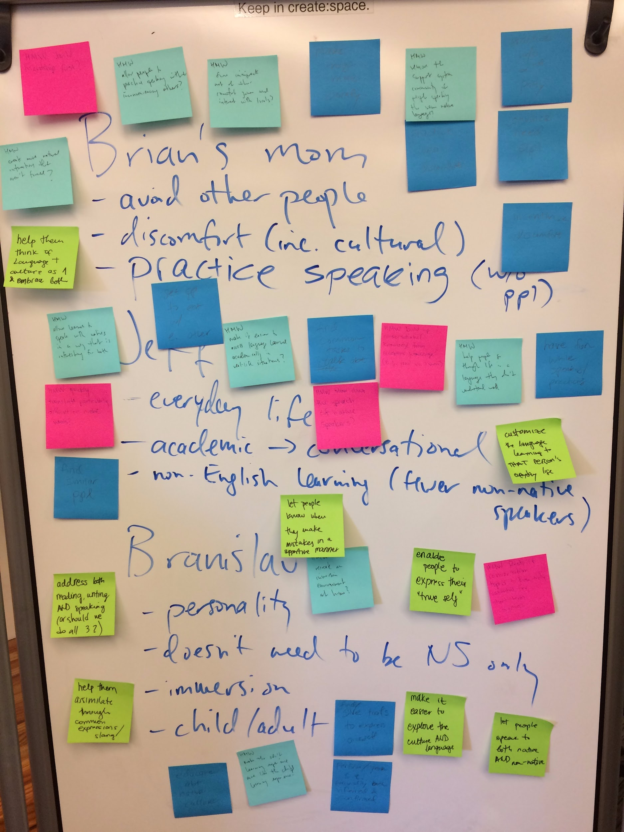
Notes:
Themes: doing activities, expanding the comfort zone, and allowing for self-expression
why you selected the specific 3 solutions you created prototypes for

Slide 10
How Might We…
Customize language learning to the person’s everyday life and self-expression?

Slide 11
How Might We…
Customize language learning to the person’s everyday life and self-expression?

Slide 12
How Might We…
Customize language learning to the person’s everyday life and self-expression?
Connect learners and speakers to get out of the virtual space and do everyday/mutually liked activities?

Slide 13
How Might We…
Customize language learning to the person’s everyday life and self-expression?
Connect learners and speakers to get out of the virtual space and do everyday/mutually liked activities?

Slide 14
How Might We…
Customize language learning to the person’s everyday life and self-expression?
Connect learners and speakers to get out of the virtual space and do everyday/mutually liked activities?
Get people comfortable with being uncomfortable?

Slide 15
How Might We…
Customize language learning to the person’s everyday life and self-expression?
Connect learners and speakers to get out of the virtual space and do everyday/mutually liked activities?
Get people comfortable with being uncomfortable?

Slide 16
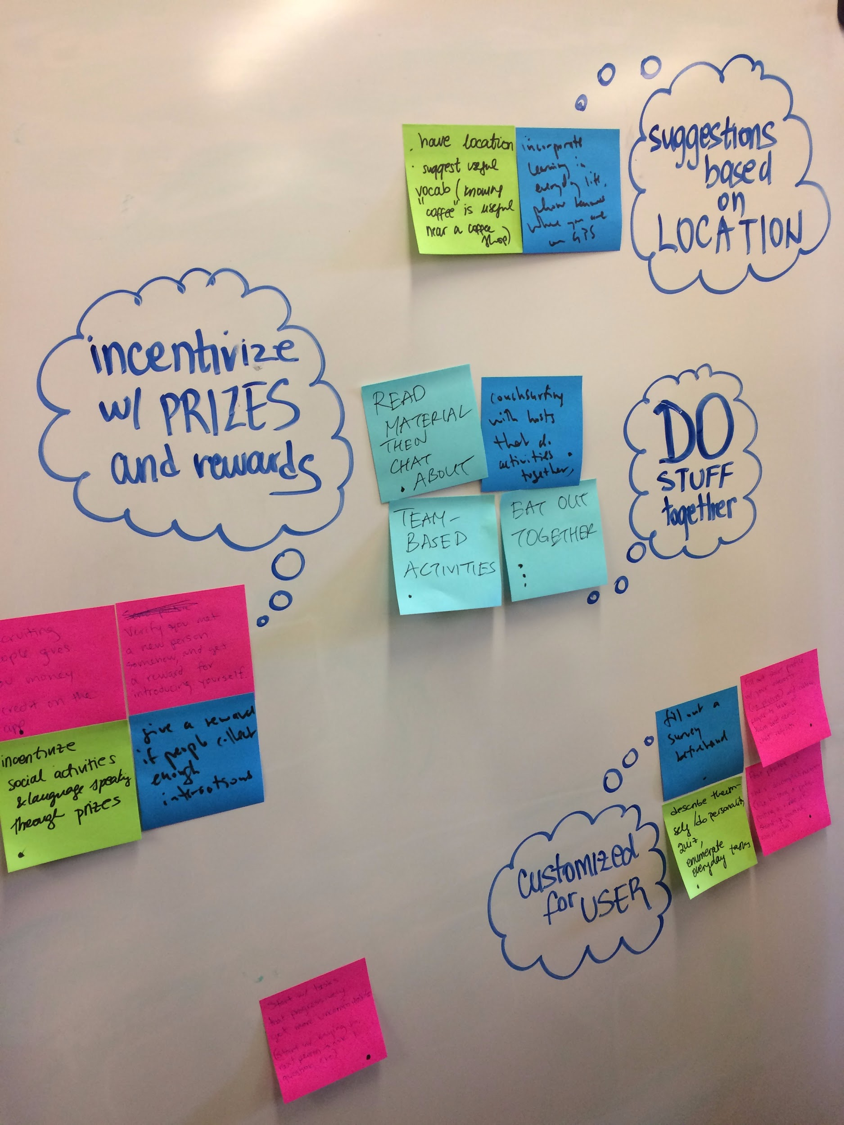
Experience Prototype #1: Location

Slide 17
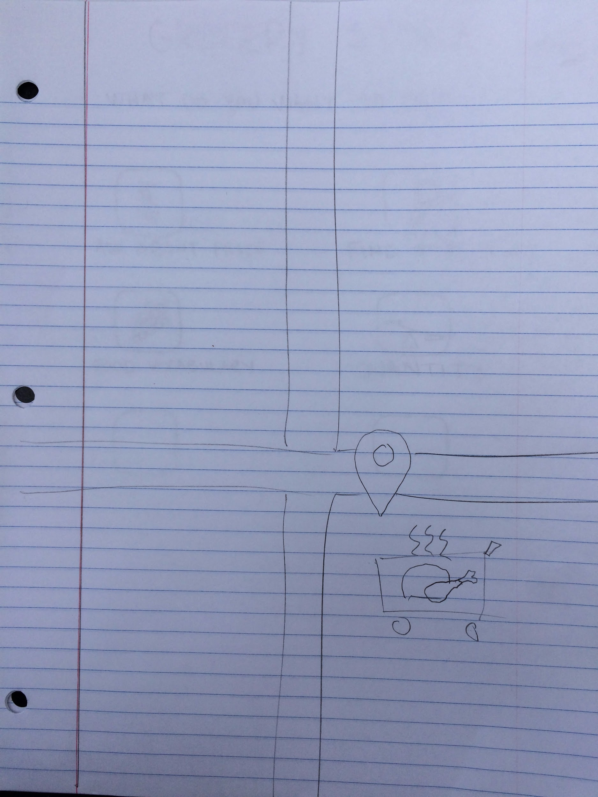
Experience Prototype #1: Location

Slide 18
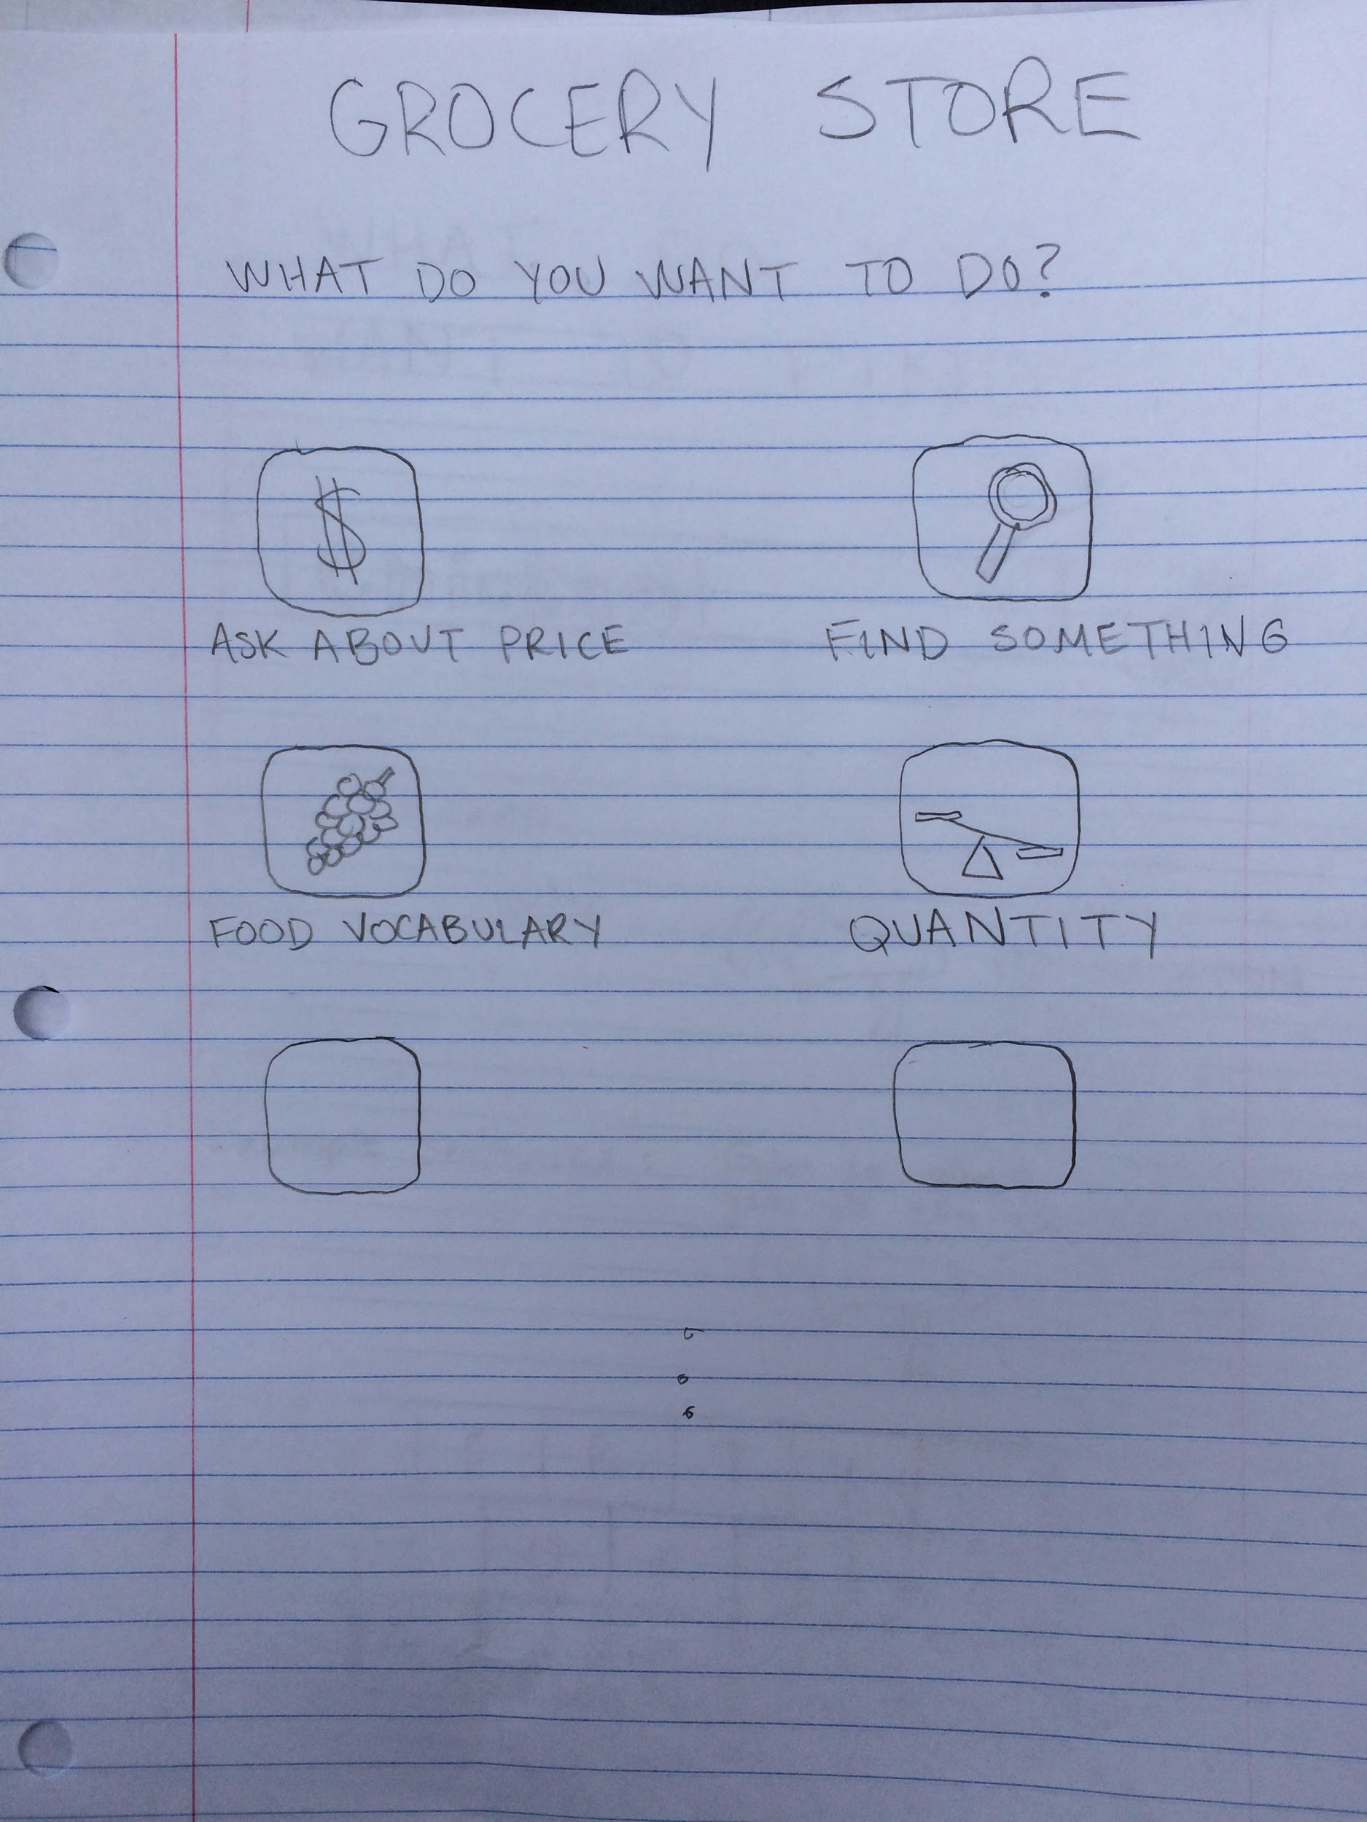
Experience Prototype #1: Location

Slide 19
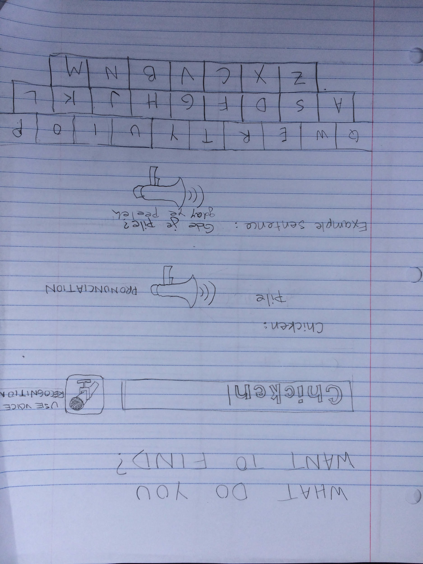
Experience Prototype #1: Location

Slide 20

Prototype #1 Results
Things that worked
Users enjoyed location-based suggestions

Slide 21

Prototype #1 Results
Things that worked
Users enjoyed location-based suggestions
Things that didn’t work
The first two screens

Slide 22

Prototype #1 Results
Things that worked
Users enjoyed location-based suggestions
Things that didn’t work
The first two screens
New, surprising learnings
Our idea is no different from a traditional dictionary app

Slide 23
Validity of Prototype #1
Learners need access to different words depending on context.

Slide 24

Validity of Prototype #1
Learners need access to different words depending on context.

Slide 25
Validity of Prototype #1
Learners need access to different words depending on context.
Learners would want to navigate thru menus to find specific phrases.

Slide 26

Validity of Prototype #1
Learners need access to different words depending on context.
Learners would want to navigate thru menus to find specific phrases.

Slide 27
Validity of Prototype #1
Learners need access to different words depending on context.
Learners would want to navigate thru menus to find specific phrases.

Slide 28
Validity of Prototype #1
Learners need access to different words depending on context.
Learners would want to navigate thru menus to find specific phrases.
May be more useful to provide suggestions without prompting at all.

Slide 29

Validity of Prototype #1
Learners need access to different words depending on context.
Learners would want to navigate thru menus to find specific phrases.
May be more useful to provide suggestions without prompting at all.

Slide 30
Experience Prototype #2: Mutual Activities

Slide 31
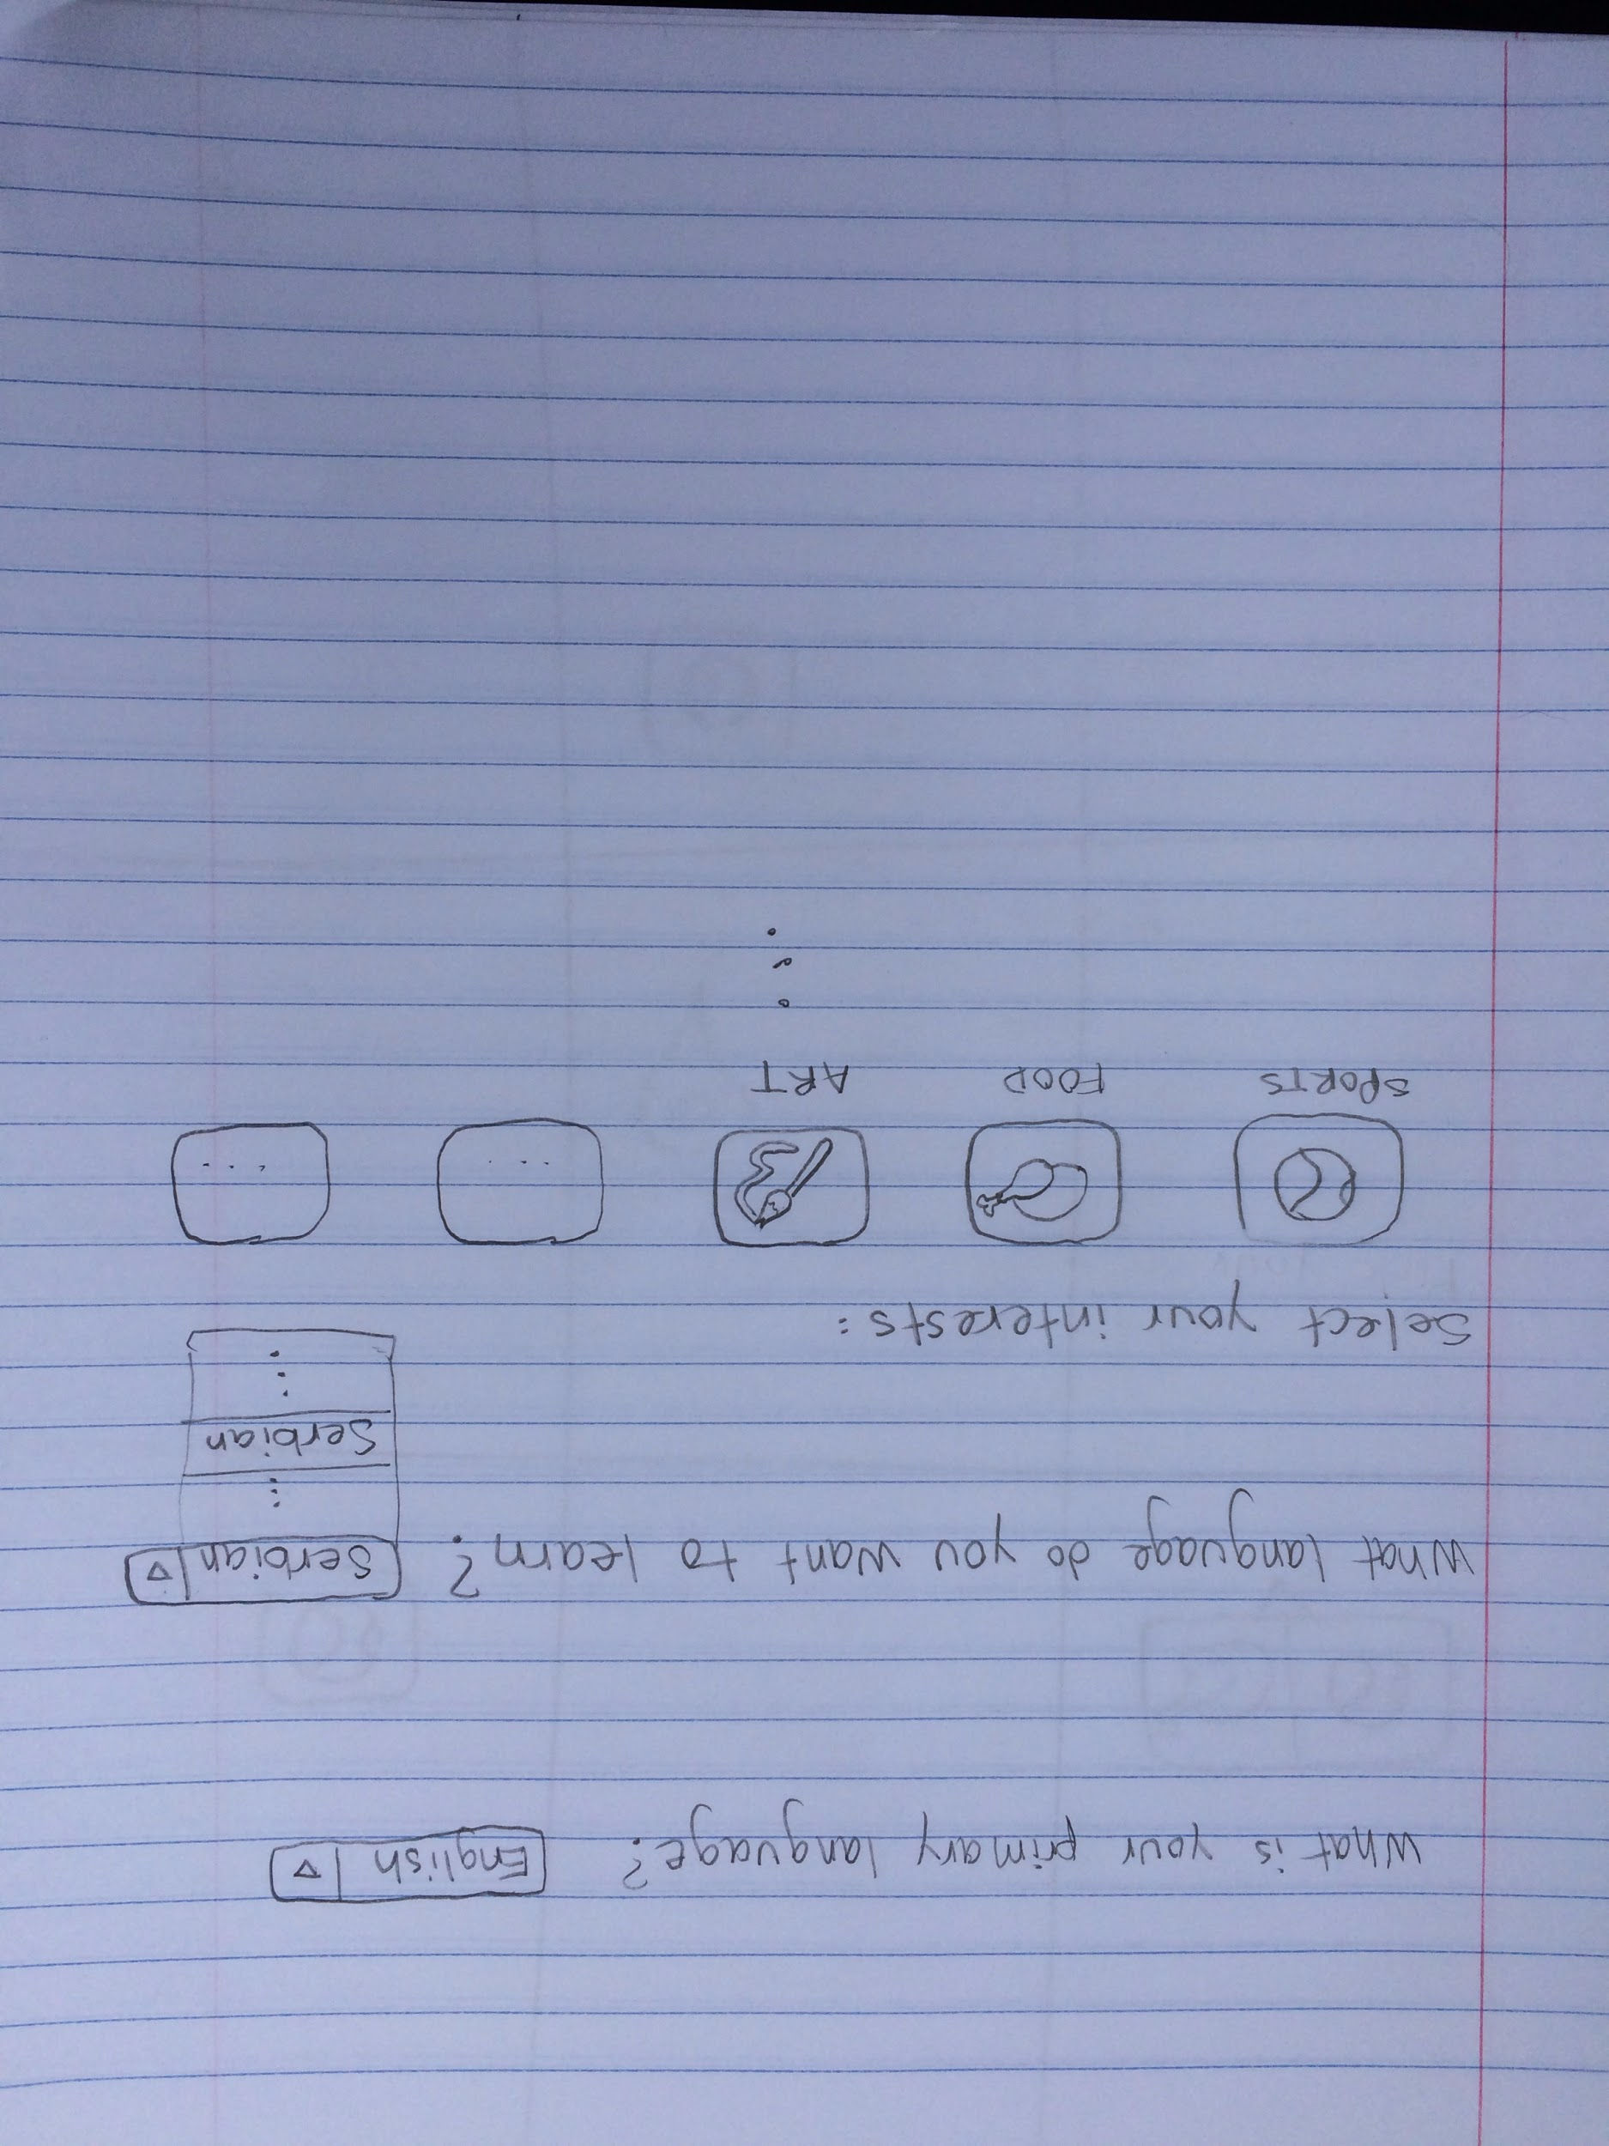
Experience Prototype #2: Mutual Activities

Slide 32
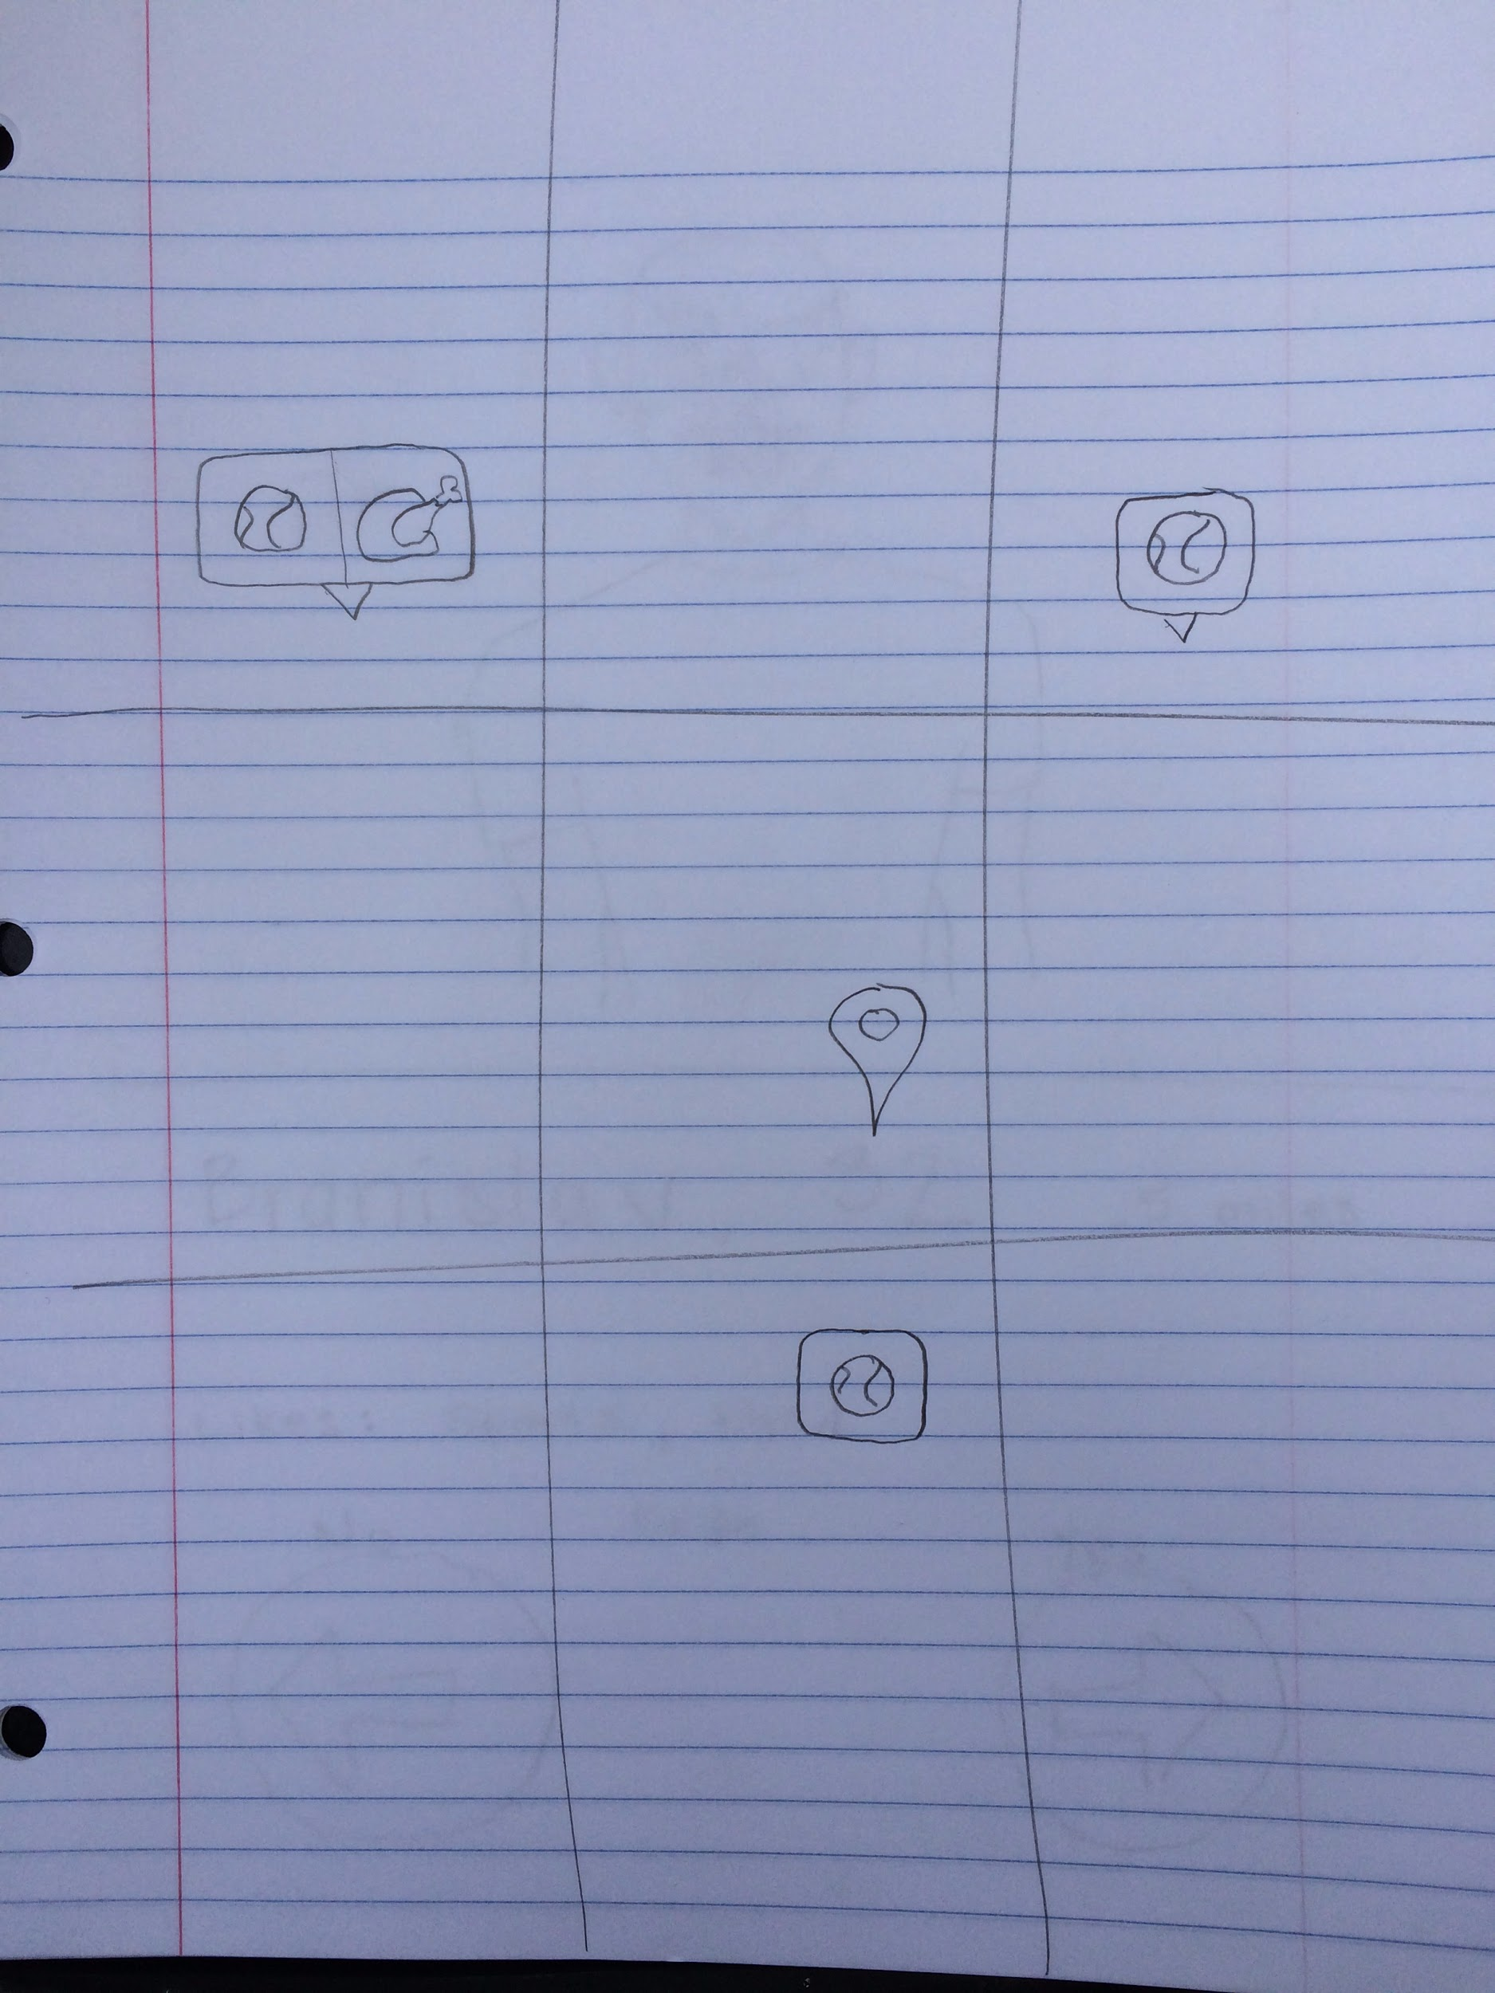
Experience Prototype #2: Mutual Activities

Slide 33
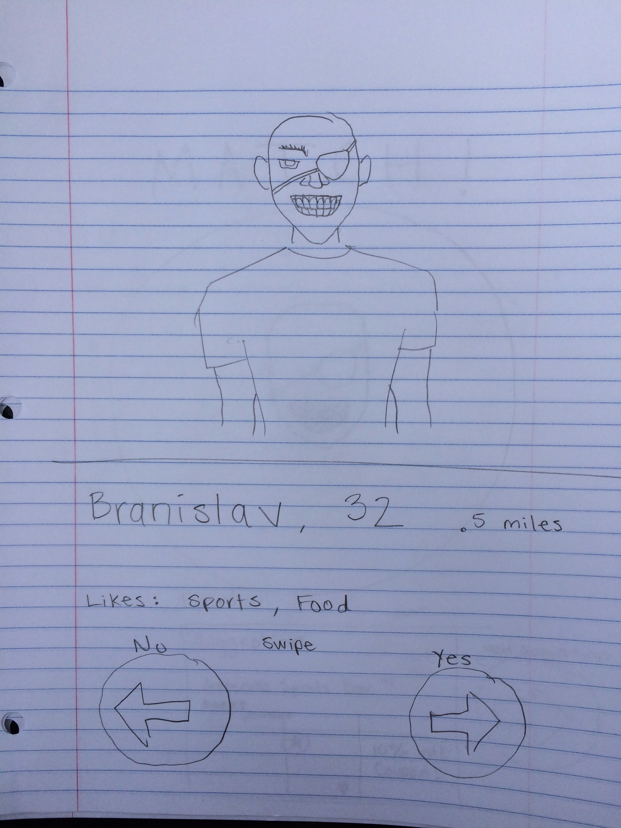
Experience Prototype #2: Mutual Activities

Slide 34
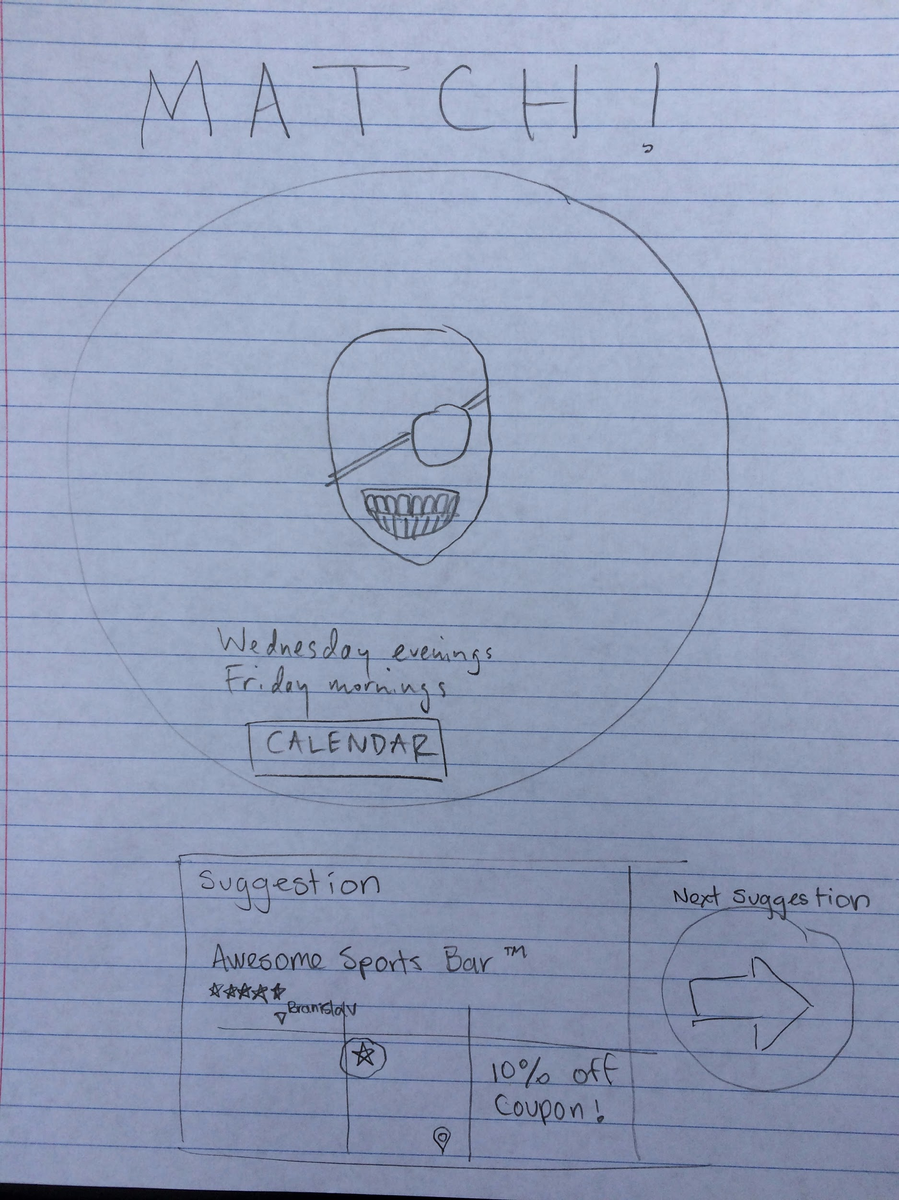
Experience Prototype #2: Mutual Activities

Slide 35

Prototype #2 Results
Things that worked
Do stuff together!

Slide 36

Prototype #2 Results
Things that worked
Do stuff together!
Tinder similarity

Slide 37

Prototype #2 Results
Things that worked
Do stuff together!
Tinder similarity
Things that didn’t work
Meeting someone you hardly know

Slide 38

Prototype #2 Results
Things that worked
Do stuff together!
Tinder similarity
Things that didn’t work
Meeting someone you hardly know
New, surprising learnings
Doing stuff together != effective long-term language learning

Slide 39
Validity of Prototype #2
Notes:
Our assumption that people would want to do activities with others who have the opposite language profile was confirmed, but our assumption that people would be comfortable with meeting others immediately without exchanging messages first was not confirmed.

Slide 40
Experience Prototype #3: Personalization

Slide 41
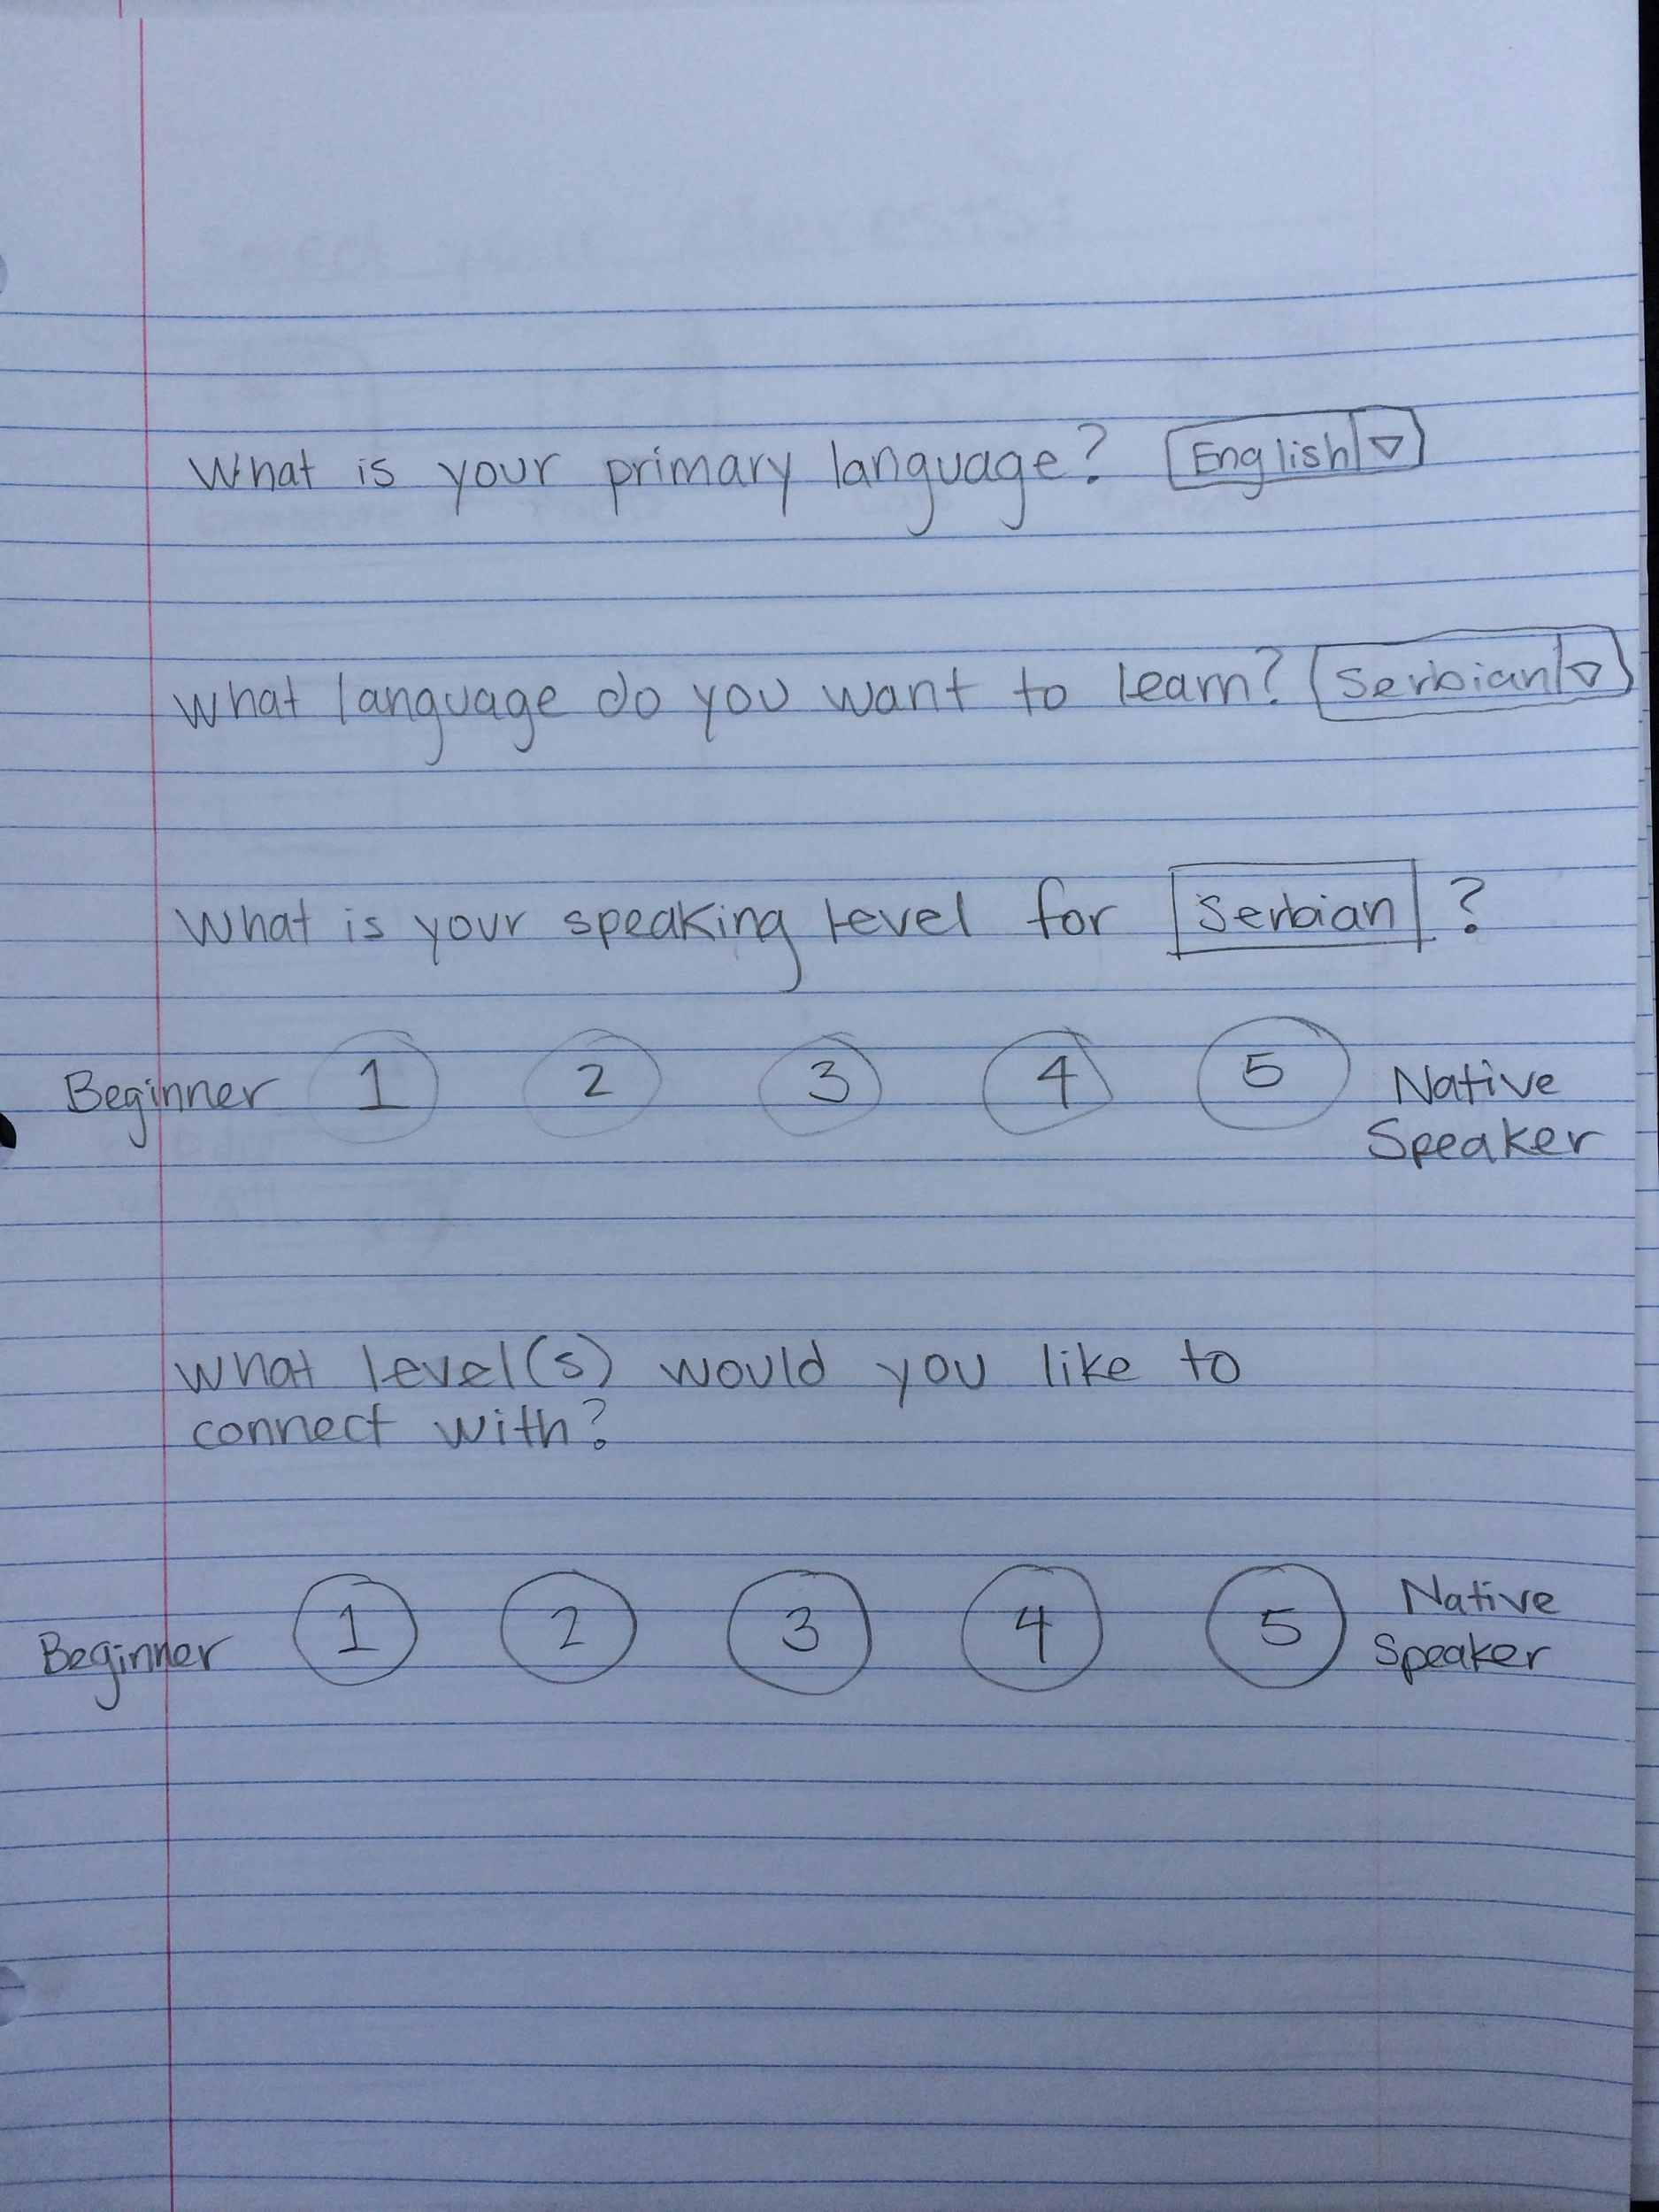
Experience Prototype #3: Personalization

Slide 42
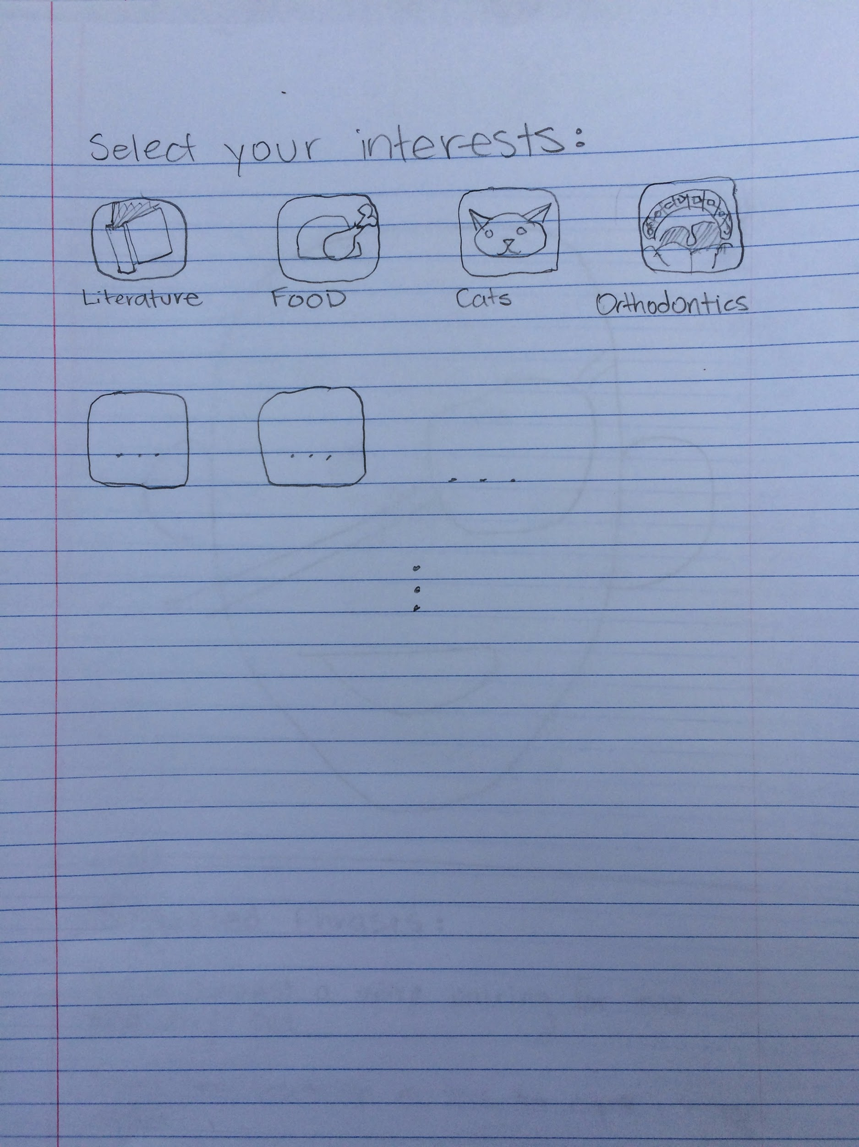
Experience Prototype #3: Personalization

Slide 43
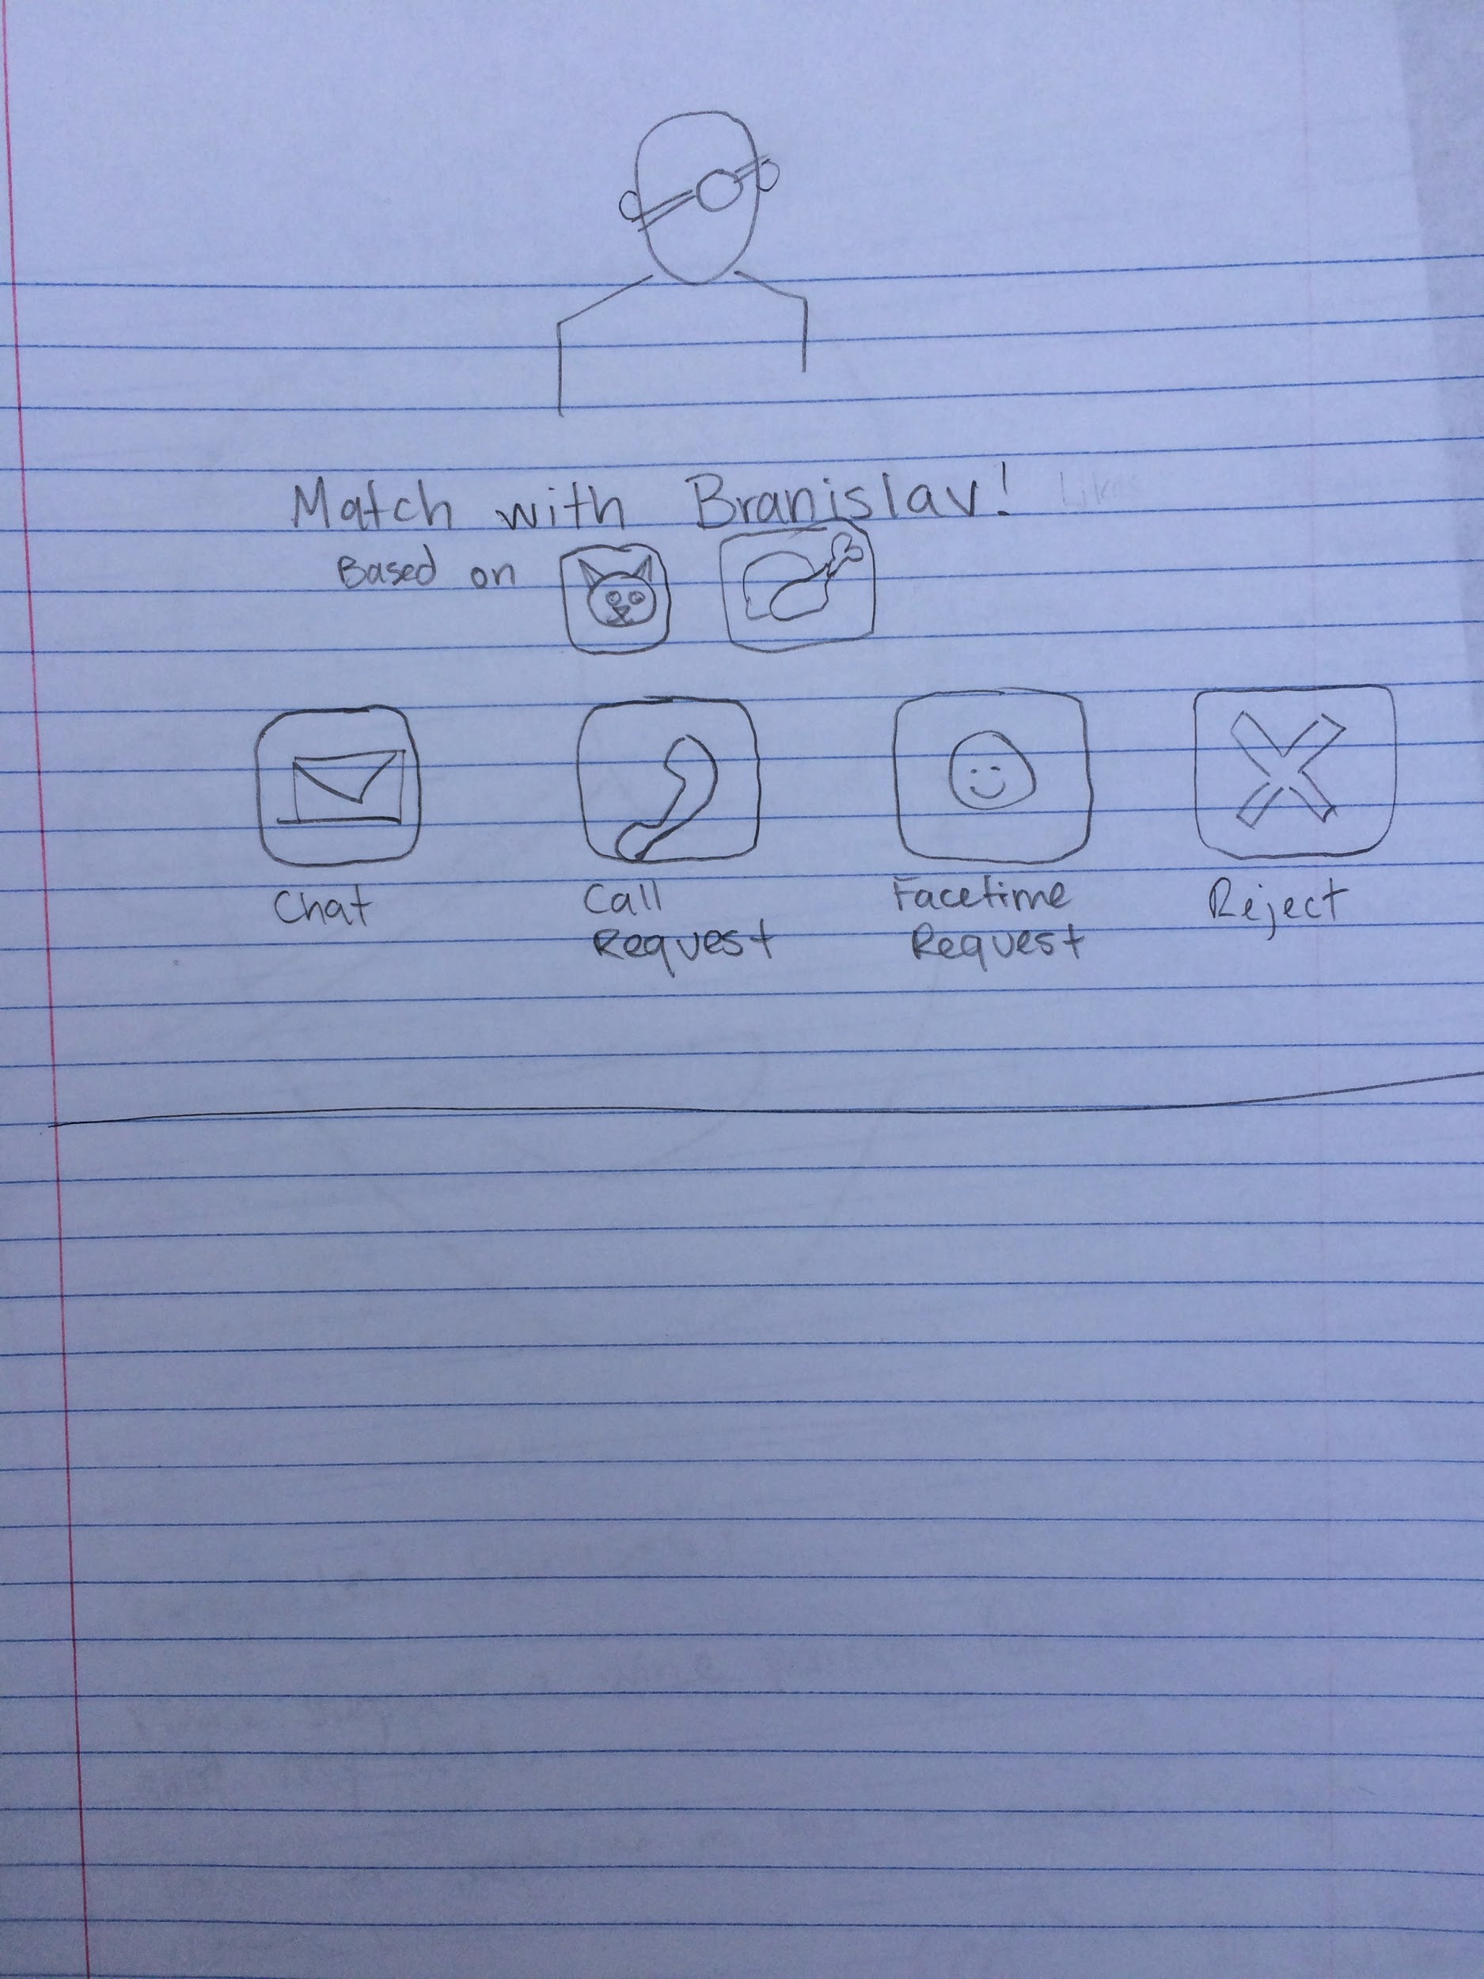
Experience Prototype #3: Personalization

Slide 44
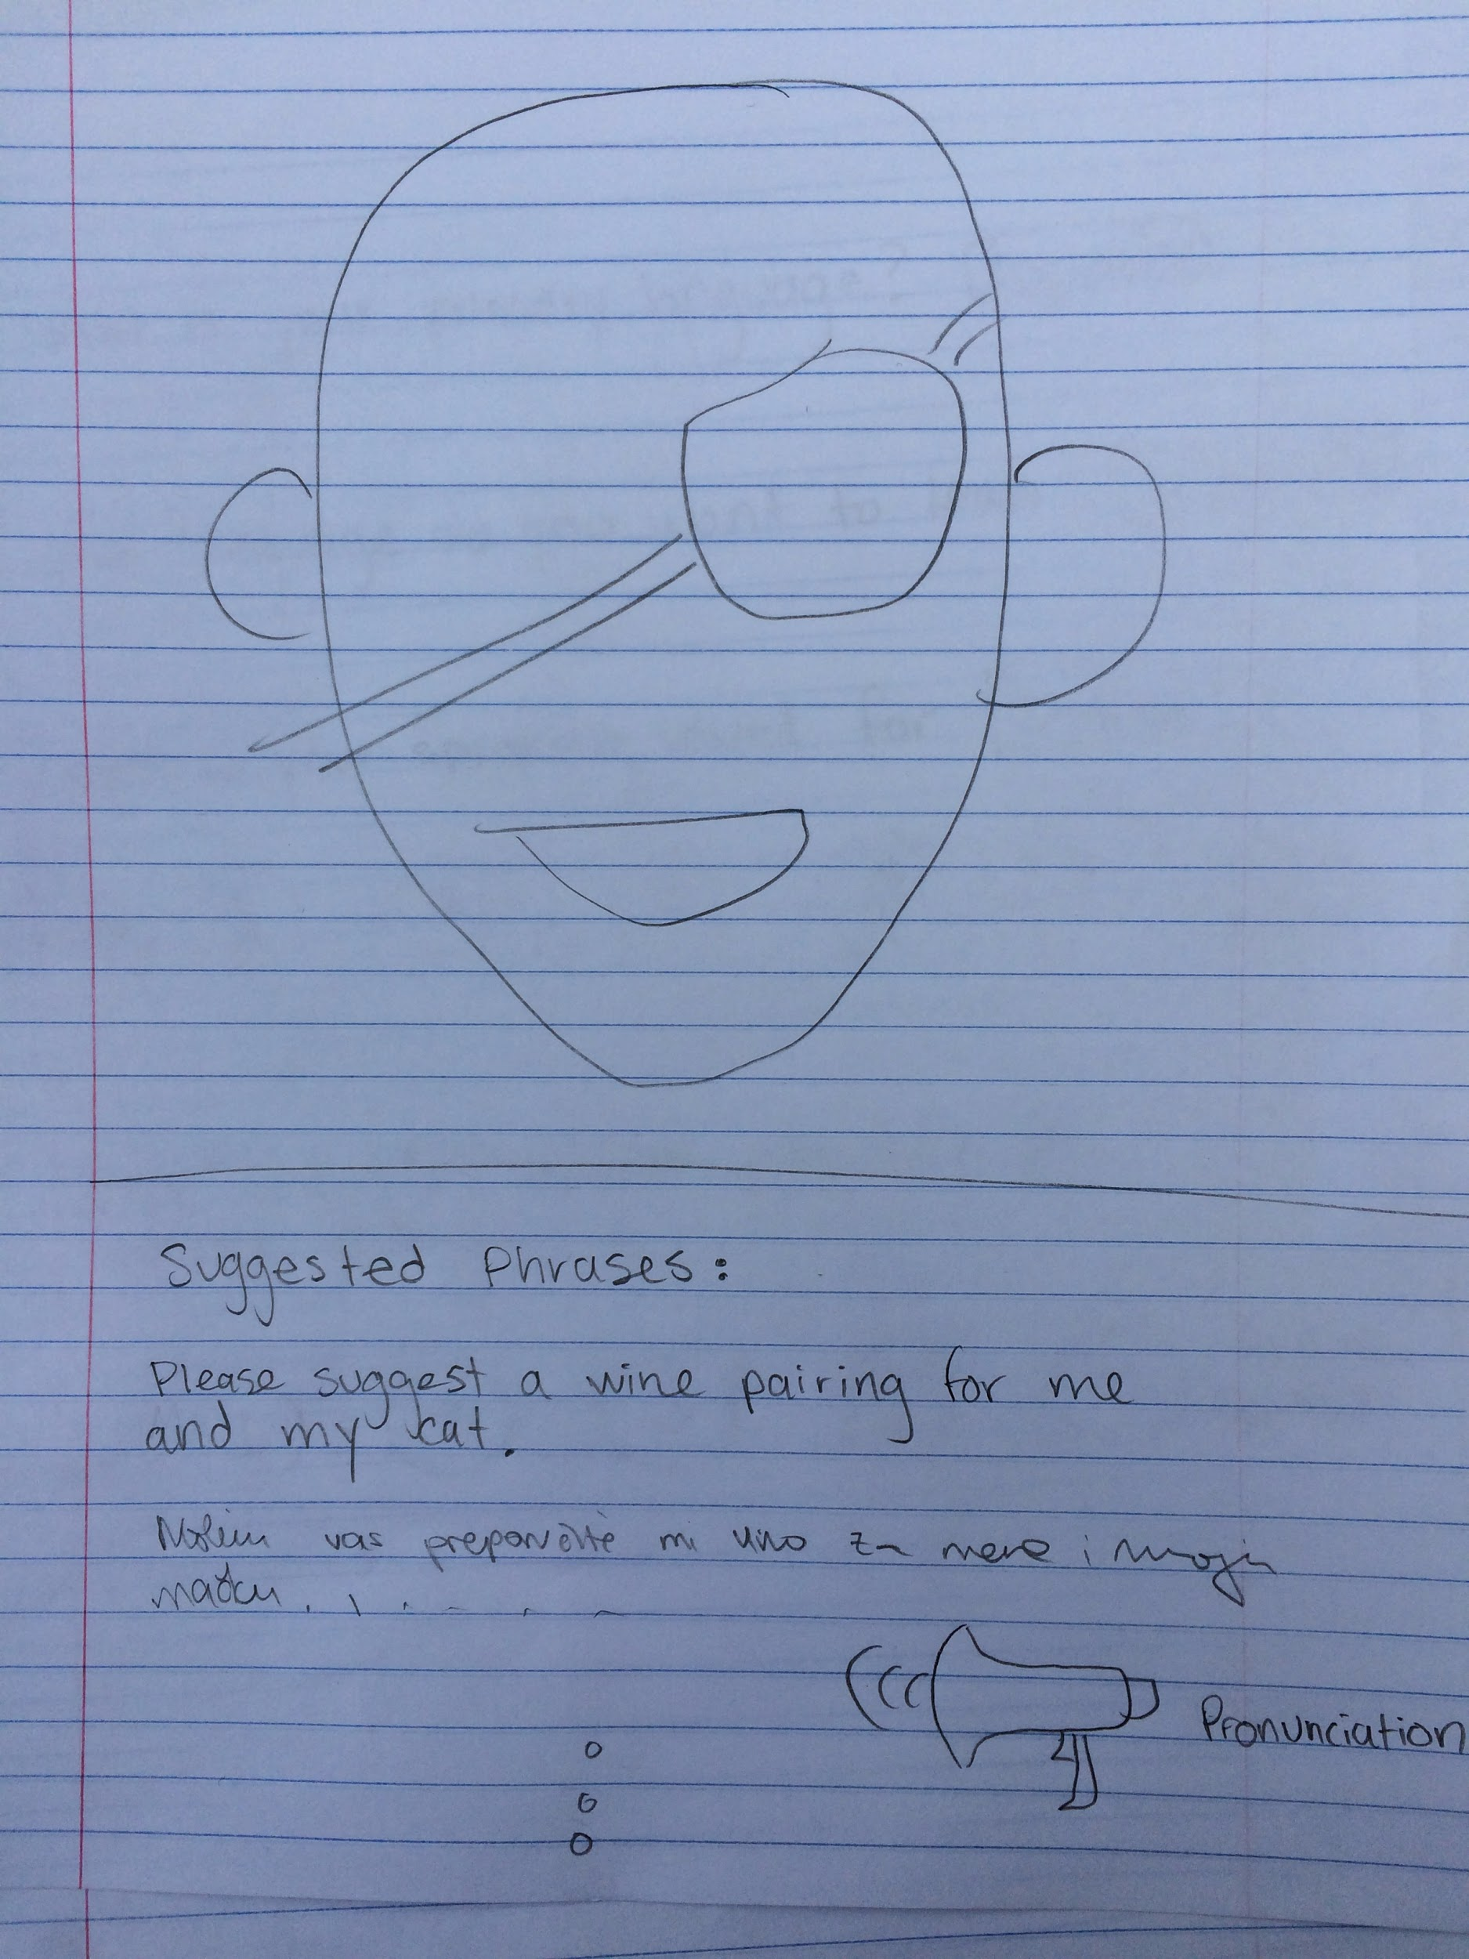
Experience Prototype #3: Personalization

Slide 45

Prototype #3 Results
Things that worked
Meet new people!

Slide 46

Prototype #3 Results
Things that worked
Meet new people!
Things that didn’t work
I can’t meet them…

Slide 47

Prototype #3 Results
Things that worked
Meet new people!
Things that didn’t work
I can’t meet them…
New, surprising learnings
The user started suggesting features of Prototype #2: Mutual Activities!

Slide 48

Validity of Prototype #3
Learners want to express their true selves, talk about their own interests, and feel comfortable while doing so.
BUT they still show a willingness to still get out there and actually meet people!

